Slide 1


Final Project Presentation
Option 5 – Credit Risk Dataset
Enrico Sain

Slide 2
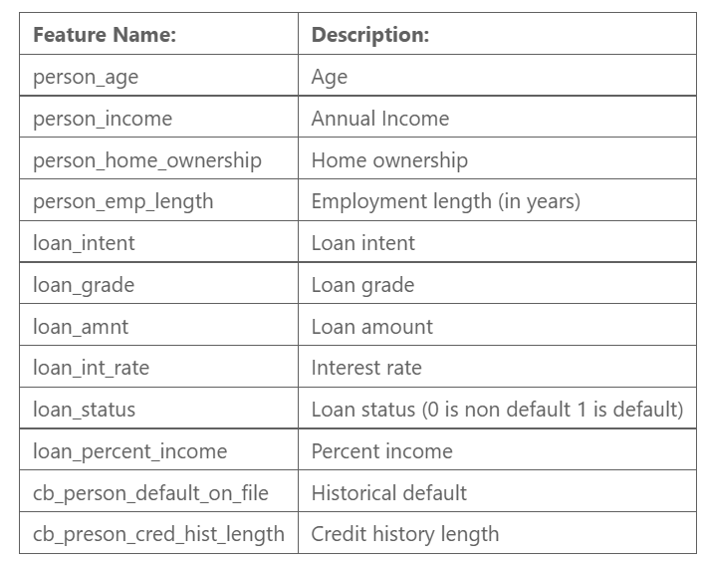
Problem Statement
The dataset contains simulated credit bureau data
The dataset is composed of 12 columns:
11 Features
1 binary target (loan_status)
Problem statement: predict the customer loan status
Problem type: binary classification (supervised learning)
(source: https://www.kaggle.com/datasets/laotse/credit-risk-dataset)
Notes:
solitamente scegliamo il modello che ha performance migliori

Slide 3
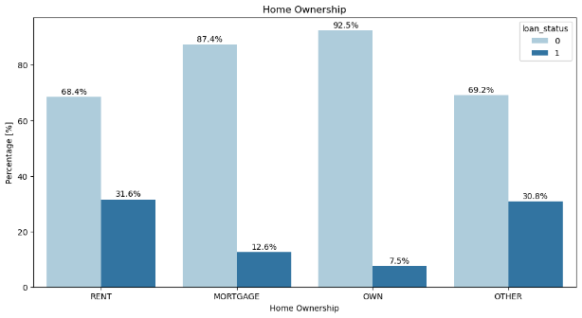
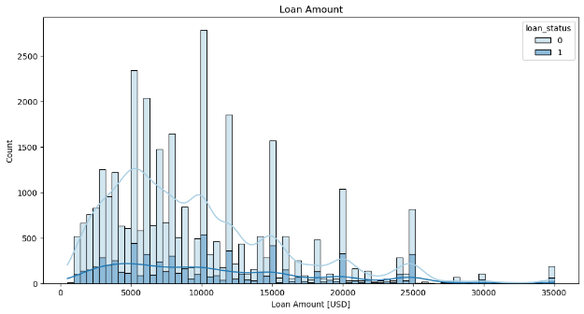
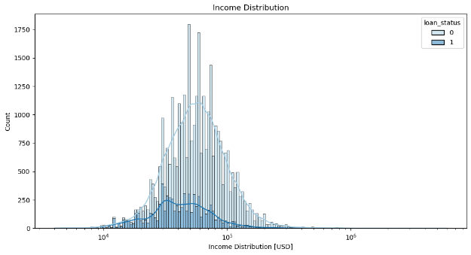
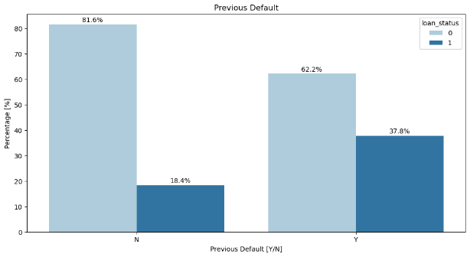
Exploratory Data Analysis
Notes:
solitamente scegliamo il modello che ha performance migliori

Slide 4
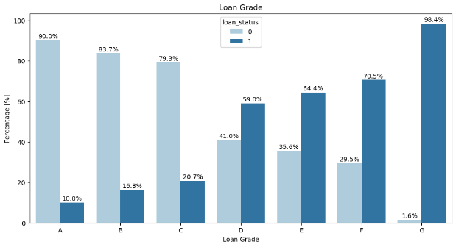
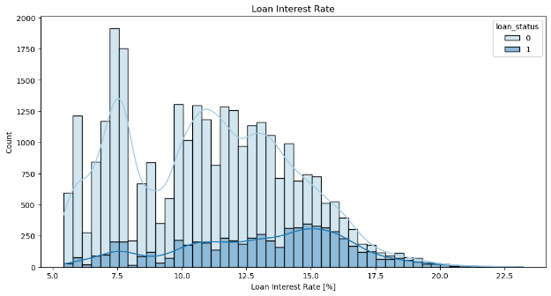
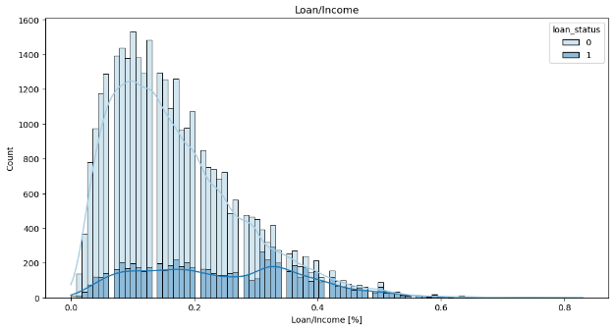
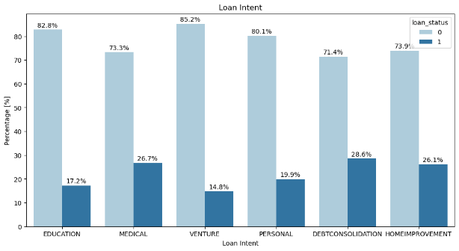
Exploratory Data Analysis
Notes:
solitamente scegliamo il modello che ha performance migliori

Slide 5
Exploratory Data Analysis
Default Customer Profile:
Defaulted customers have a lower income than non defaulted customers.
Most of the defaulted customers rent a house, and only a few of them are home owners.
Most of the defaulted customers apply for a loan for debt consolidation, medical reasons or home improvement.
Loan grade for defaulted customers is generally lower than all other customers, a reason why this feature could be strictly correlated with the target.
Interest rates and loan/income ratio are generally higher for defaulted customers.
Defaulted customers show also a higher number of previous defaults than non defaulted customers.
Other Insights:
Moderately imbalanced dataset (78% class 0, 22% class 1)
165 duplicate rows
person_age highly correlated with cb_person_cred_hist_length
Outliers in person_age (age above 122 years) and employment_length
3981 Nans (887 in person_emp_length and 3094 in loan_int_rate)
Notes:
solitamente scegliamo il modello che ha performance migliori

Slide 6
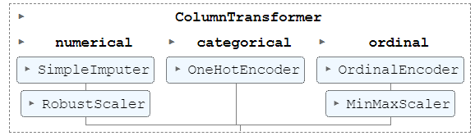
Preprocessing
Features
Pipeline
Ordinal Categorical
loan_grade
Nominal Categorical
person_home_ownership
loan_intent
Numerical
person_age
cb_person_default_on_file
person_income
person_emp_length
loan_amnt
loan_int_rate
loan_percent_income
Data Cleaning (outliers, duplicate rows, highly correlated features)
Train test split with stratify option in order to create train and test subset with the same target class ratio
Preprocessing pipelines for each different kind of feature
Notes:
solitamente scegliamo il modello che ha performance migliori

Slide 7
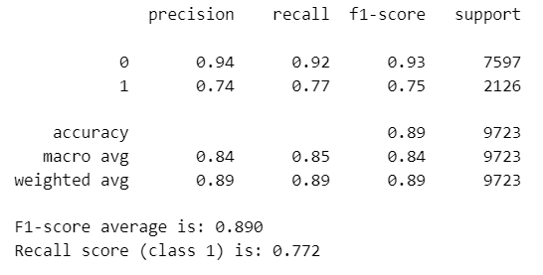
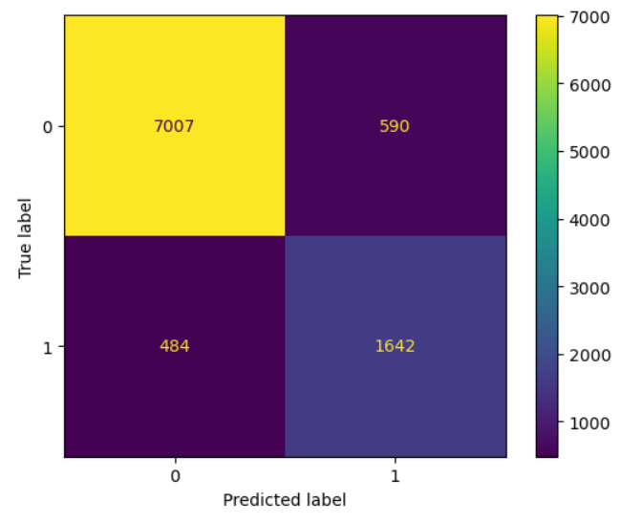
Model Evaluation and Selection
1. Classification Report
Baseline
Decision Tree
Ensemble
Random Forest
Ensemble Tuned*
Random Forest
Voting Classifier
XGBoost
CatBoost
XGBoost
CatBoost
Hard Voting
Soft Voting
KNN
Logistic Regression
2. Confusion Matrix
3. Overfit check
4. Precision Recall curves**
*Ensemble models tuned with RandomizedSearchCV using weight hyperparameters to cope with unbalanced dataset
**only for Ensemble tuned
Notes:
solitamente scegliamo il modello che ha performance migliori

Slide 8
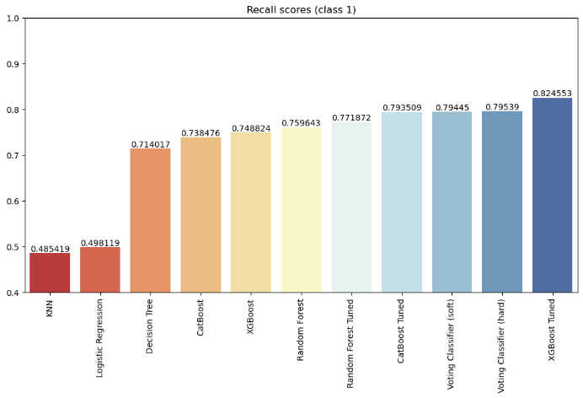
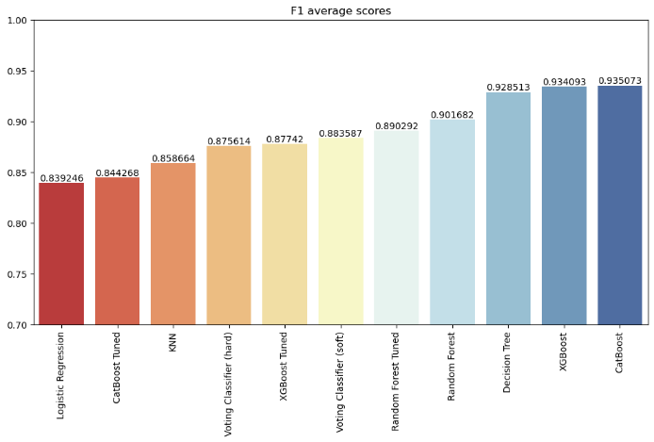
Model Evaluation and Selection
+1,6%
Random Forest
+7,4%
CatBoost
+10,1%
XGBoost
Tuning strategy: Recall score Optimization

Slide 9
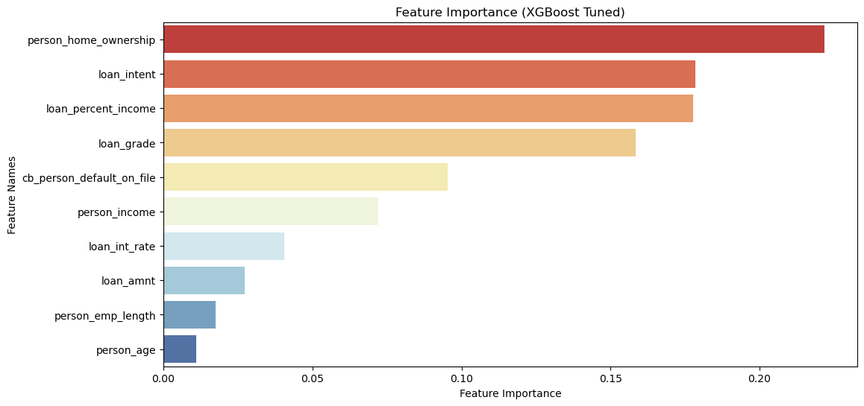
Feature Importance
Notes:
solitamente scegliamo il modello che ha performance migliori

Slide 10
Conclusions and Future Work Recommendations
Conclusions:
We have trained 11 different ML models on the credit_risk_dataset and compared the f1 number and recall metrics calculated on the test set for each of them. The best model if we look at recall is certainly the optimized XGBoost with a weighted average f1 score of 88%, a high recall of 82.5% on class 1 and the best precision recall curve. Voting classifier (soft) or Random Forest tuned are still very good options if we are looking to achieve a more balanced model with slightly higher f1 and slightly lower recall.
Recommendations for future work:
Deploy other strategies to cope with unbalanced datasets and compare the results (downsampling, upsampling, synthetic data augmentation e.g. SMOTE, use of imbalanced learn library etc.)
Try more hyperparameters and higher ranges in order to improve the tuning results
Try Bayesian Optimization as a more efficient way to improve hyperparameter tuning
Train more Ensemble methods based on Decision Tree (e.g. LightGBM)
Drop least important features from the dataset and retrain the model
Assign weights to each loan in order to optimize models that minimize financial loss
Notes:
solitamente scegliamo il modello che ha performance migliori

